Slide 1


Skipper
Extreme Blue 2019
Incident Response for Multicloud Applications

Slide 2

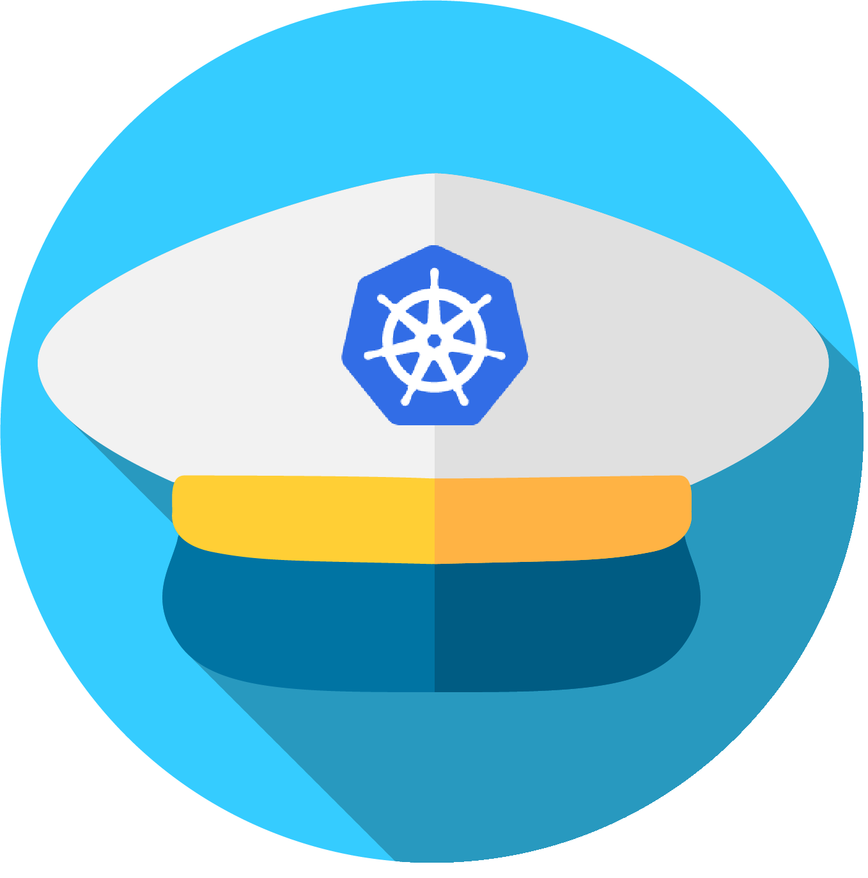
Meet Skipper.
Skipper is an interactive terminal tool designed to help multicloud application operators zero in on problems as quickly as possible. Using Skipper, operators can search across all Kubernetes resources associated with their applications in one centralized location. By surfacing relevant details and highlighting anomalous application behavior, Skipper helps operators spend less time finding where a problem is occurring and more time solving it.
Icon: Smashicons via flaticon.com

Slide 3

Our User

Slide 4

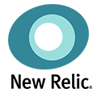

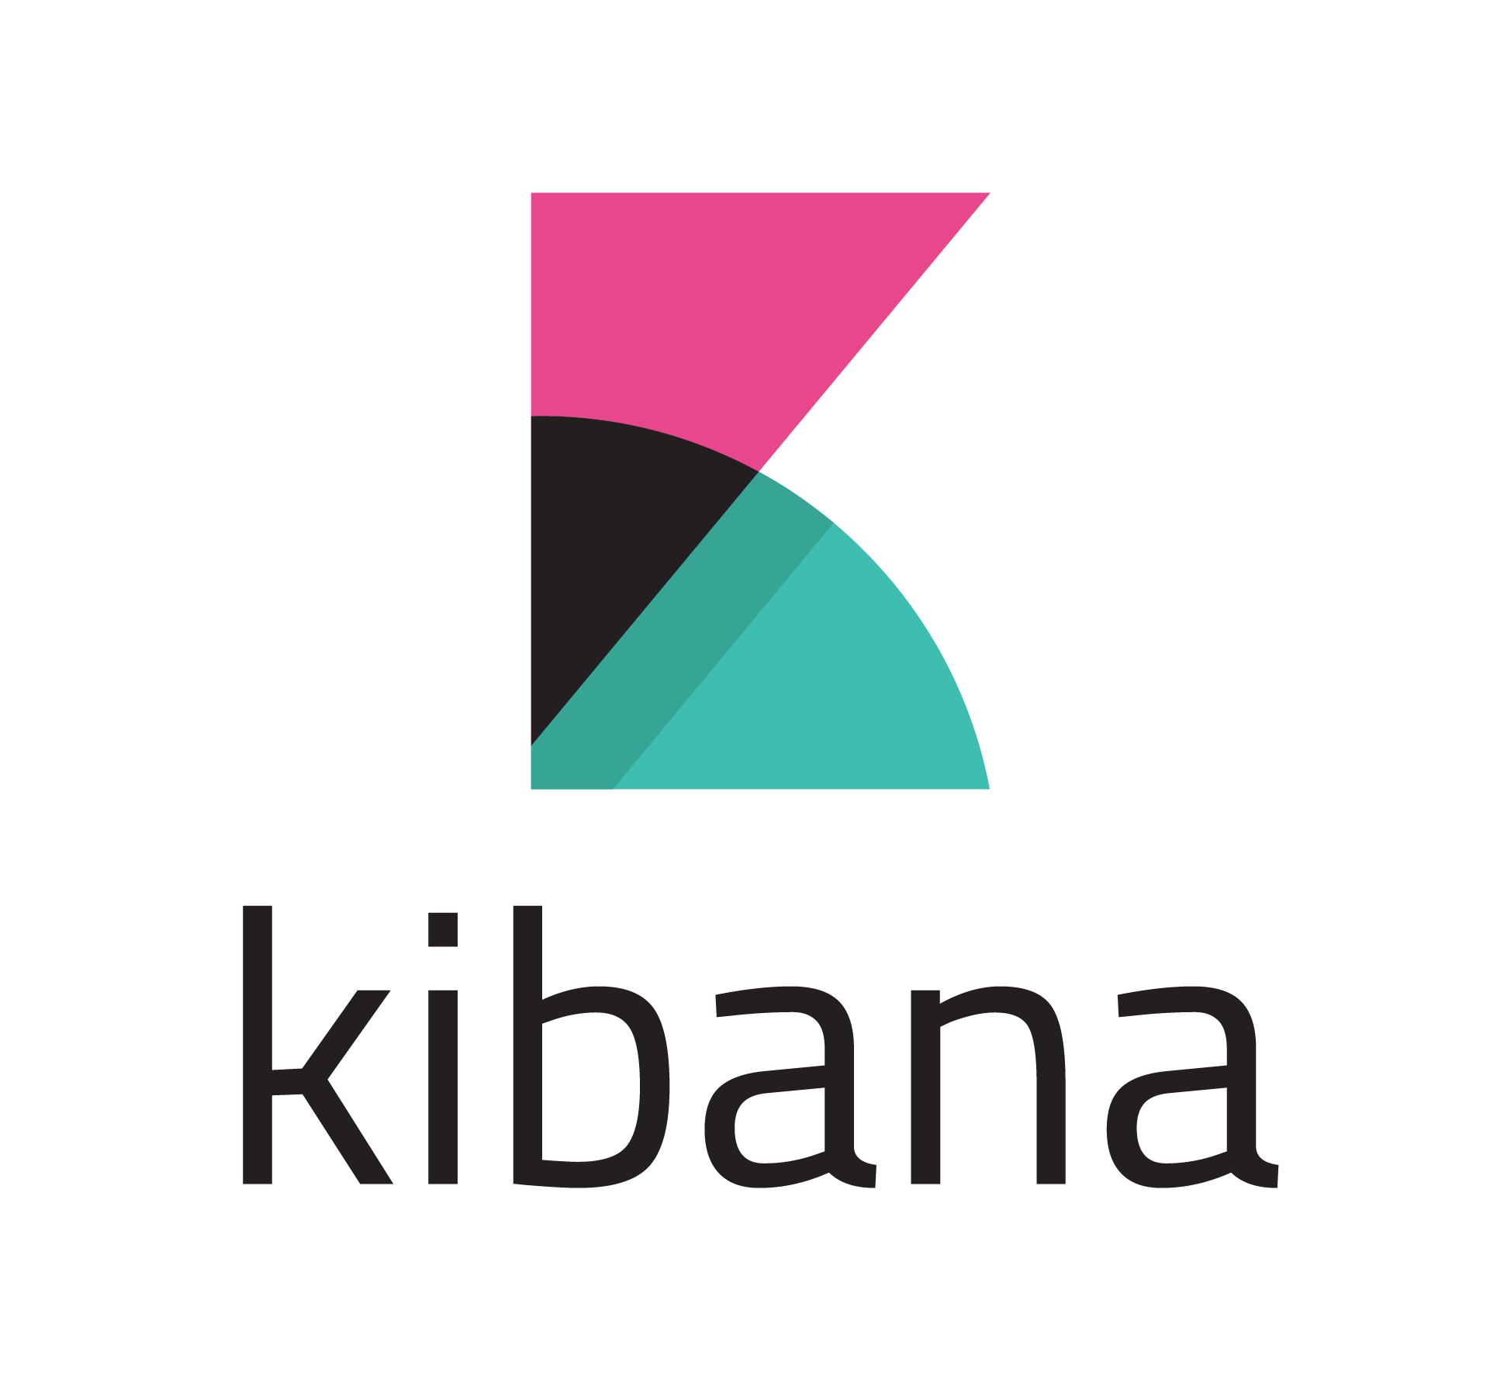
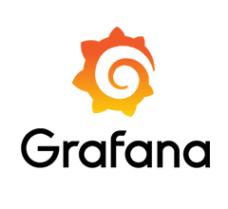
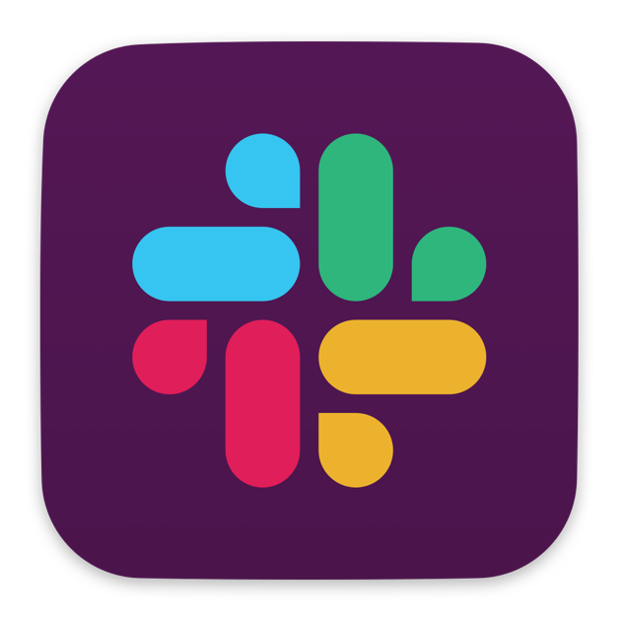

User Persona: John, IT Operator
John manages a Kubernetes-based application. It’s likely that John did not build the application, but is responsible for ensuring that it is running consistently and meeting established SLA requirements. When John is not responding to incidents, his role entails responding to customer support tickets, building in automation to reduce repeat issues, pushing updates to improve app efficiency and security, or helping the dev team integrate new features.
ENVIRONMENT: 120 – 240 nodes hosted across ~3-5 Cloud providers
TEAM: John works on a larger team of 7-9 operators, who rotate who is “on-call” to respond to incidents. He has a wider team of developers and SMEs to reach out to if he is not able to diagnose or fix a problem and needs help from someone with more expertise
Tools:

Slide 5
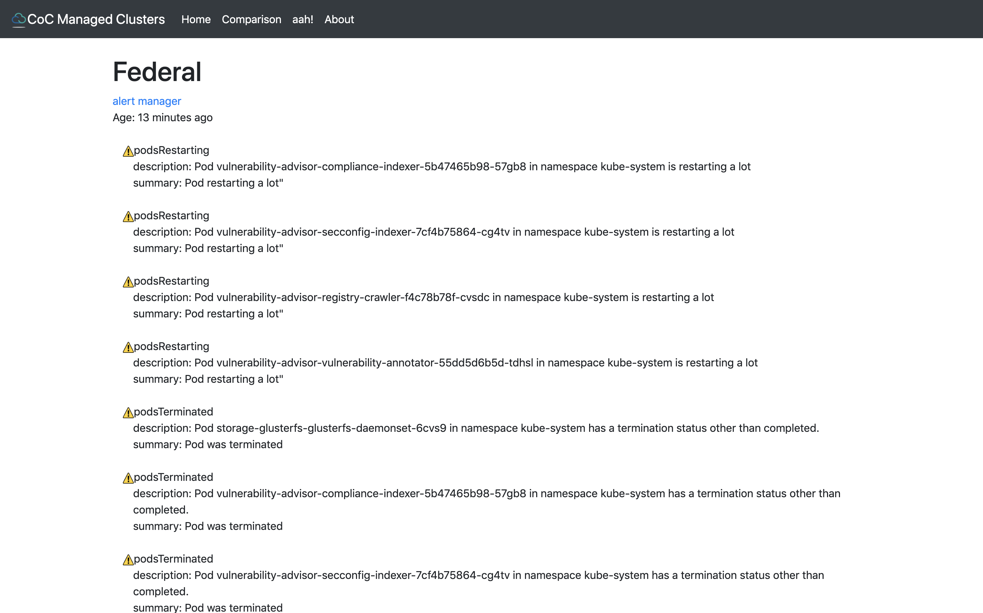
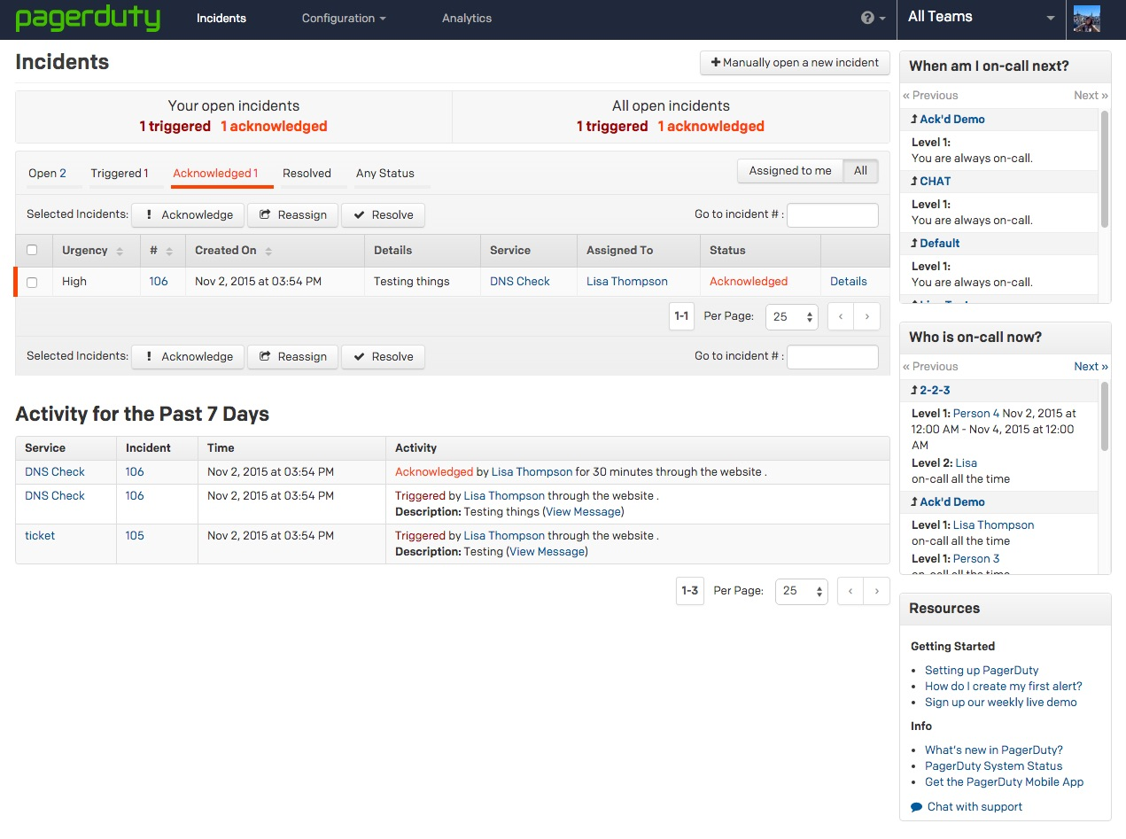
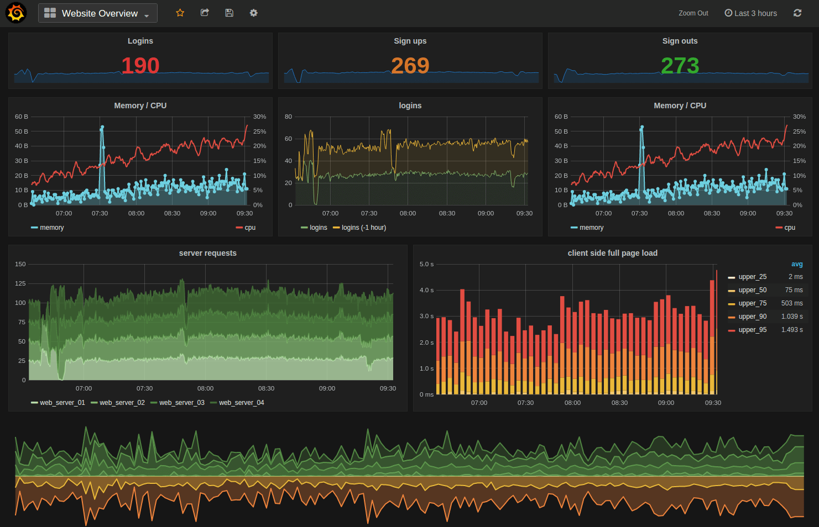
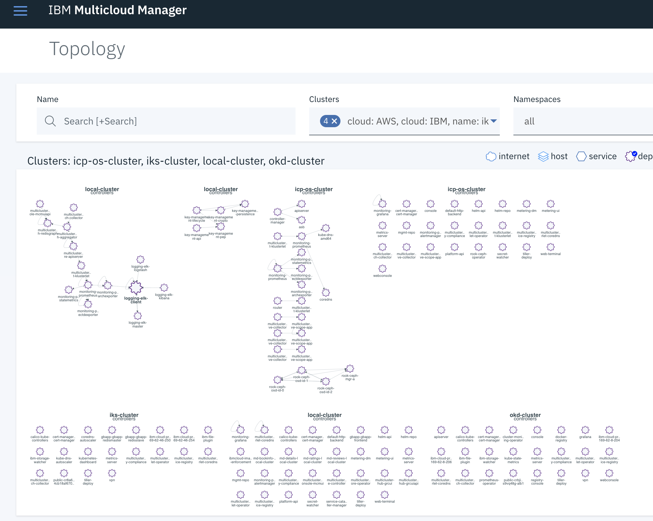
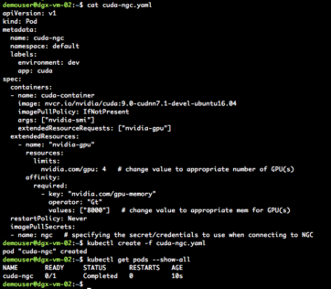
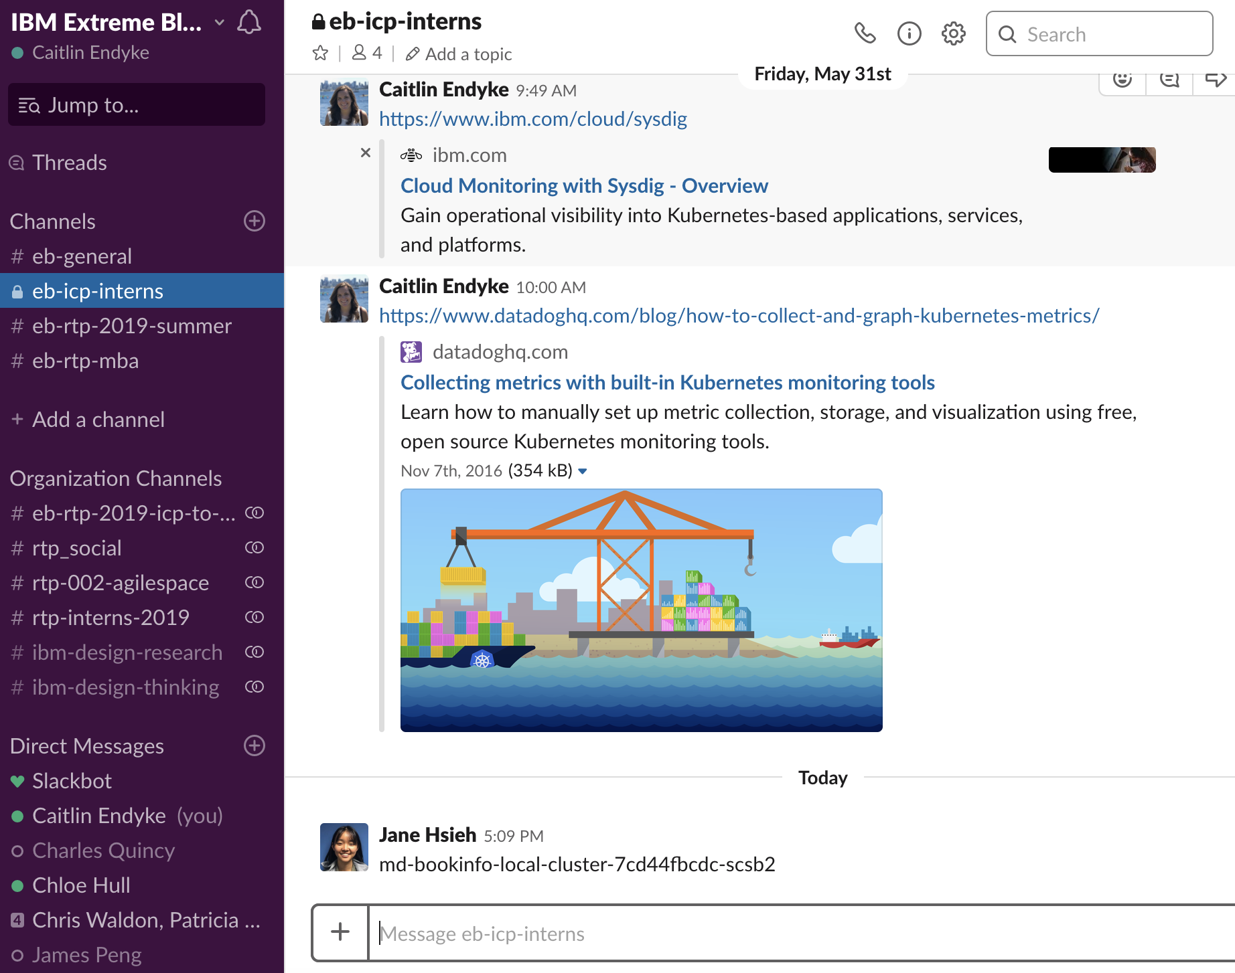
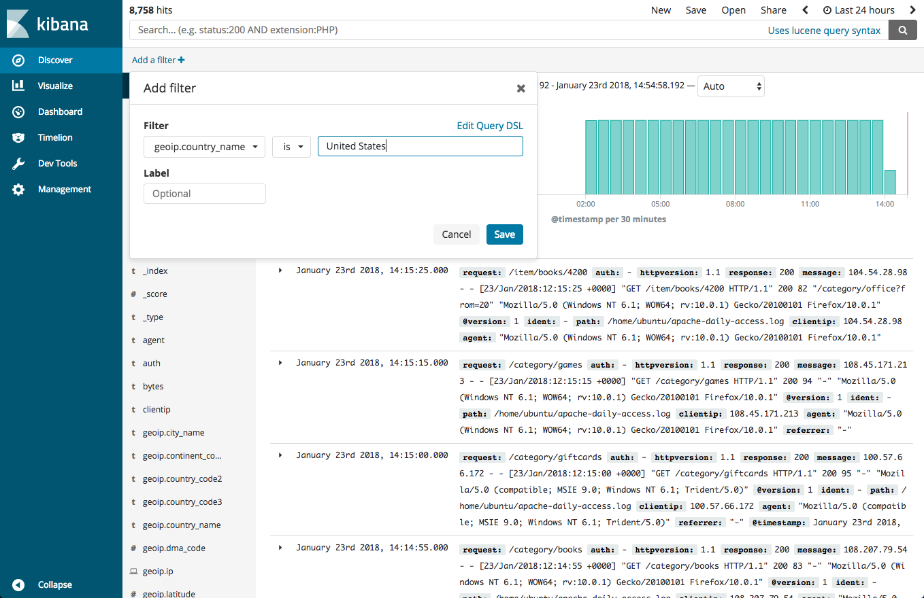
Companies have an average of 6-40 different application monitoring tools
Src:IDC Futurescape: Worldwide Cloud 2016 Predictions – Mastering the Raw Materials of Digital Transformation

Slide 6

Problem Statement
Multicloud, Kubernetes-based application operators struggle to quickly triage issues when parts of their applications are failing.
We just got burned yesterday – [a piece of our application] was down and we couldn’t figure out why. It took 2 hours of investigation just to find the problem
Kubernetes orchestration and multicloud deployment have allowed enterprise organizations to quickly scale workloads and run their applications more efficiently. But it creates complicated application architectures that are obfuscated by multiple layers of Kubernetes abstraction.

Slide 7

Operator pain point: Unclear Application Hierarchy
Because John didn’t build the application he manages, he doesn’t have a macro view of how it’s architected, and relies on “tribal knowledge” to learn how things are put together. He often resorts to troubleshooting with “gut reaction” guesswork.
Issues observed during user interviews:
Difficulty remembering the correct cluster or namespace name in order to look up that context to investigate. Drill down into one area only to realize what they were looking for must be in a different place
“A lot of our issues are because another service that our app relies on is having an issue…no real way to learn these dependencies if you didn’t develop it. Tribal knowledge is a problem.”
“A lot of support is dependent on who is kept up to date [on application architecture]”

Slide 8
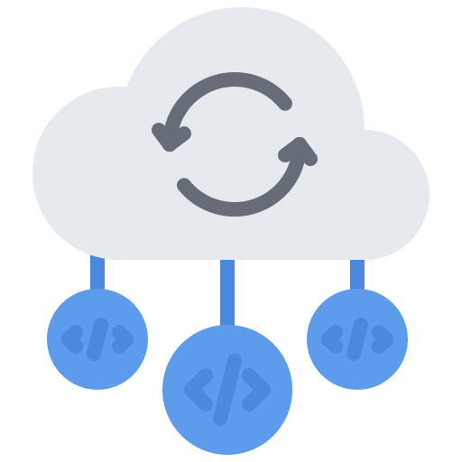
Operator pain point: No Cross-Cluster Visibility
Few tools allow John to see relevant resources that live across clusters in different clouds. As applications are increasingly deployed across clusters (and clouds), this pain point increases
Issues observed during user interviews:
Existing tools are unable to represent granular application details across clusters – operators were opening multiple tabs of the same dashboard (one for each cluster) or issuing several CLI commands in order to get relevant info
Terminal commands to see resources on each cluster were complicated and took time to enter (lots of time spent flipping between dashboards to copy the resource name, then back to terminal to enter it with the full command)

Slide 9



Operator pain point: “Dashboards” are Inefficient
John has to flip between many screens (and wait for each interface to load) in order to get all of the information he needs to build an accurate hypothesis of what might be going wrong in his application
Issues observed during user interviews:
Dashboards were not dynamic enough to give all relevant information (i.e. logs, YAMLs, metrics and resource lists) in one location
Time spent waiting for GUI interfaces to load and flipping between multiple tabs/dashboards was very frustrating for operators we observed
Existing dashboards were good at a giving a macro, holistic view of the application/environment, but struggled to give all granular information needed to efficiently troubleshoot

Slide 10







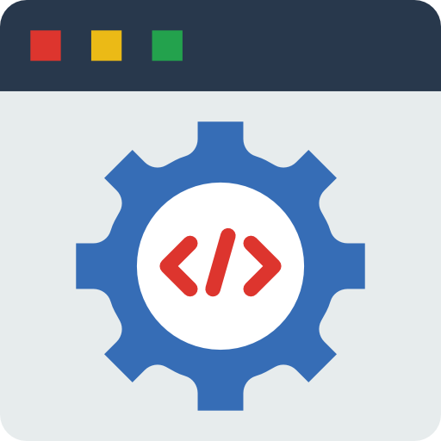

Current tool user journey
Cluster View (in terminal OR dashboard)
Begins to investigate individual clusters. Looking for pods/services that aren’t running. Uses a series of K8 commands to pull up info, repeats commands for each cluster
Paging System
Receives page from established policy to alert of issue
Incident Manager
Dashboard (sometimes linked from paging system) to provide more info about what triggered the alert
Logs (in terminal OR dashboard)
Finds a pod that is unhealthy. Pulls up logs in terminal or log dashboard to see if it gives relevant info
Runbooks (if exist)
Check to see if there is a Runbook to handle similar problem. Follows steps to attempt a fix.
YAML (in terminal)
Depending on log info, checks the YAML file to see what an individual resource is communicating with
Metrics Dashboard
Views application-level metrics to scan for spikes in activity or anomalous behavior to begin building hypothesis of what is going wrong
Terminal to fix
If has enough info, uses terminal (or opens editor) to edit YAML or issue other exec command to fix
Messaging Tool
Communicate with team throughout
Image src: Freepik, Nikita Golubev, Dinosoft labs, prettycons, via flaticon.com

Slide 11



What Operator KPIs are we targeting?
Mean Time to Response
Mean Time to Identification
Mean Time to Resolution
Image src: Freepik, Nikita Golubev,via flaticon.com

Slide 12
The Solution

Slide 13
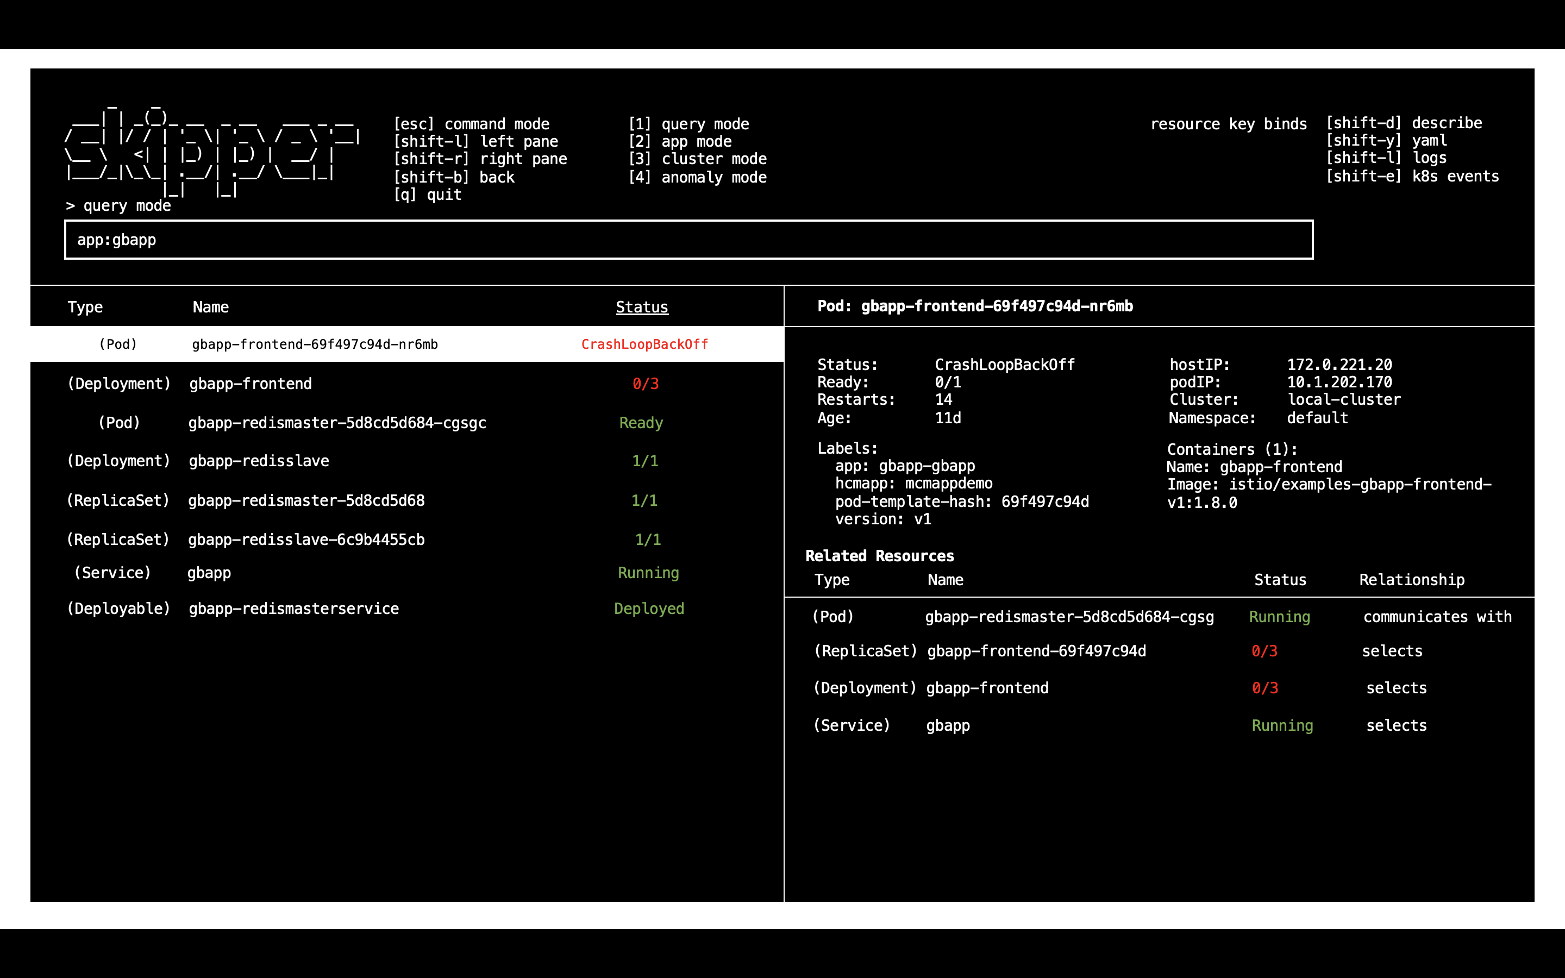

Slide 14
Mission Statement
Skipper is an interactive terminal tool that helps operators navigate the complex relationships between Kubernetes elements in multi-cluster and multi-cloud applications.
Skipper aims to decrease the time spent triaging application incidents, allowing operators to quickly scan application infrastructures and pinpoint exactly where an issue is originating. By reducing time to incident identification, we expedite issue resolution - minimizing application downtime and avoiding costly revenue and productivity losses.

Slide 15




User Value of Skipper
ONE TOOL TO RULE THEM ALL
Gives operators one, centralized program to view relevant details for all of their Kubernetes resources
CLEAR RESOURCE HIERARCHIES
Organizes resources into intuitive hierarchies to give operators a more structured way to browse through elements and information
INTUITIVE TERMINAL UI
Presents everything within a text-based terminal interface, eliminates the time spent switching between GUI dashboards and CLI tools
GRANULAR INFO IN ONE CLICK
Expedites the triage process by surfacing logs, YAML files, metric data, and detailed resource descriptions all within the same application
SEAMLESS NAVIGATION
Eliminates time spent issuing complicated commands to switch contexts between clusters/clouds
ILLUSTRATES RELATIONSHIPS
Shows related resources to illustrate dependencies – eliminating reliance on “tribal knowledge” to know what elements rely on each other

Slide 16


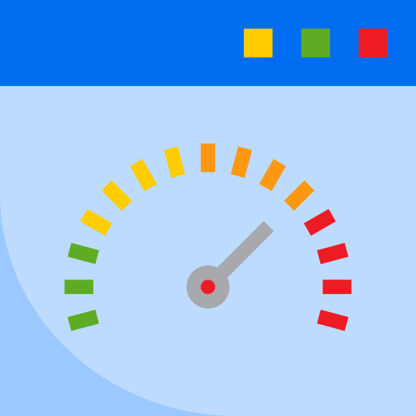
Why a terminal program?
Eliminates dashboard overload
Skipper puts all relevant information AND commands into one, centralized location. Removes the need to flip between metrics, K8 dashboards, log data, and CLI to diagnose and begin to fix
Lightweight = Speed
Over and over, we witnessed operators spend valuable time waiting for their complicated GUI dashboards to load. As a lightweight terminal application, Skipper is lightning fast
“Meet them where they are”
Operators like the terminal. Skipper brings the information to where they are already most comfortable, and allows them to execute more advanced commands in place
Image src: Smashicon, via flaticon.com

Slide 17




The Four Modes of Skipper
APPLICATION MODE
CLUSTER MODE
QUERY MODE
ANOMALY MODE
Shows all resources associated with an application
Shows how K8s resources are distributed across clusters
Allows searching for individual resources or by type, status, etc
Displays all resources acting in error state, across environment
Image src: Vectors Market, Freepik, Smashicon via flaticon.com

Slide 18
Application Mode
Using MCM’s custom resource definitions, Application Mode shows the full hierarchy of an application – from deployables to pods – regardless of where they are deployed
application
deployable
deployment
replica set
pod
service
daemon set
stateful set
pod
pod
pod
PAIN POINTS ADDRESSED:
Operators are unfamiliar with how applications are architected and are unsure which resources belong to which application. ‘App Mode’ filters through the noise to show just the relevant elements, and maps to how Multicloud Manager categorizes K8s elements.
Image src: Vectors Market, Freepik, Smashicon via flaticon.com

Slide 19
Cluster Mode
Cluster mode allows users who may not have CRDs implemented on all of their application resources troubleshoot their full environments, and accounts for situations when where the resource is deployed may help issue identification
cluster
namespace
deployment
replica set
pod
service
daemon set
stateful set
pod
pod
pod
PAIN POINTS ADDRESSED:
Time spent getting to granular details. Operators can quickly traverse the hierarchy (from cluster to pod and back again) without having to remember resource names or enter additional CLI commands – saving time and eliminating the frustration of flipping between dashboards and the terminal
Image src: Vectors Market, Freepik, Smashicon via flaticon.com

Slide 20
Query Mode
For users who would rather “spear-fish” than browse. Gives operators the ability to search for individual resources or to filter by application, resource type, label, etc.
application name
context (cluster, namespace, etc)
resource type (service, pod, etc)
current status (pending, failed, CrashLoopBackof etc)
K8s event
PAIN POINTS ADDRESSED:
Some operators said they wanted to see a list of “everything in my application”. Query mode removes resources from the hierarchy and gives users more control to filter results down to elements that are most relevant – reducing time spent browsing if the operator already has a hypothesis (or received a policy alert with resource-level information) about the root cause of the issue
POSSIBLE QUERY FILTERS
Image src: Vectors Market, Freepik, Smashicon via flaticon.com

Slide 21
Anomaly Mode
Gives users the ability to jump right to a list of resources that are acting in error state, prioritized by Skipper’s assessed severity
statuses that indicate failure
restarts over a certain threshold
approaching resource limits (CPU, memory)
K8s events (CrashLoopBackoff, ImagePullBackOff)
PAIN POINTS ADDRESSED:
Eliminates the time spent drilling down to granular details, only to find that nothing is wrong with those particular resources. Operators mentioned sometimes not knowing where to start – anomaly mode gives users a jumping off point to begin to build hypotheses by showing everything that could be failing across their environment
ANOMALIES CAPTURED
Image src: Vectors Market, Freepik, Smashicon via flaticon.com

Slide 22

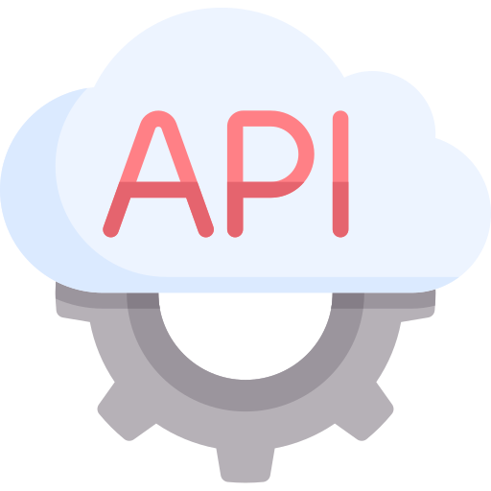

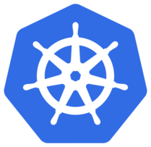
1
On startup, Skipper loads kube config file, and uses credential tokens to gain access to all of the clusters the user has permissions for
Back-end Magic
kube
config
2
Skipper creates Python Kubernetes API clients to gather information from each cluster's api-server. This information is stored locally for quick retrieval
3
All of the data Skipper collects is presented as a local interactive terminal program that operators run from their desktops

Slide 23
Business Value

Slide 24
Business Value
Reducing operator time to identification/resolution will lessen application downtime / time of reduced application performance
CUSTOMER VALUE
EXTERNAL IBM VALUE
Save operator time and cost of incident resolution
Avoid lost revenue issues that impact the end-consumer
Reduce productivity losses from internal application downtime
Maintain end-customer trust and satisfaction
Plug Skipper into larger MCM/ICP catalog to illustrate ecosystem of complementary tools
Position IBM as destination for end-to-end multicloud management, handling deployment, monitoring, and incident response
Provide superior UX for end-user to drive tool adoption
INTERNAL IBM VALUE
Save internal operator costs & time to incident resolution - for internal IBM app operators and customer support teams
Avoid unplanned application incidents and maintain SLA requirements
Notes:
CHECK CLOUD VIGILANTE

Slide 25

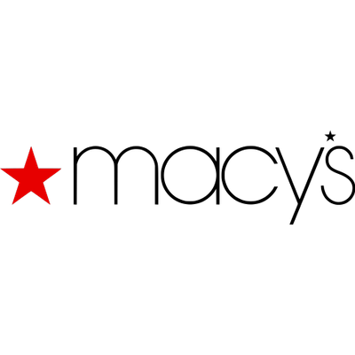
Retail
27%
biz critical apps hosted in cloud
Example Use Case:
Users report issue that they are having trouble adding items to their online shopping carts
Operators investigate. They know their front-end clusters are hosted separately from the shopping cart business logic, but they’re unsure which cluster is causing the issue (or if it’s something else)
Using Skipper, the operator can quickly see all of the Kubernetes resources associated with his application, regardless of which cluster/cloud they’re deployed on
Skipper highlights a few crashed pods in red because they are showing the error state “CrashLoopBackoff”
That gives him enough to know that he should investigate the logs, so he triggers that pane of Skipper. The logs say that the pods are failing to connect with an outside service. After confirming that service is down, he restores a backup that points to a different location, fixing the issue until the team can get the other service back up
$180,000
Annual profit savings with Skipper
$80,000 yearly profit savings with Skipper
Components of e-commerce app are deployed across cloud. Skipper reduces application downtime, limiting lost revenue from customer-facing issues that cause cart abandonment
Img src: Freekpik via flaticon.com

Slide 26


Financial Services
43%
biz critical apps hosted in cloud
Example Use Case:
Monitoring policies alert Operator that mobile app transactions are processing very slowly
The policy lists the application that has been affected, but not which pods or K8 resources might be causing the issue
The Operator uses Skipper’s anomaly mode to see a list of everything in error state across his environment
He notices that several resources are listing “ImagePullBackoff” as their status.
He selects a resource and opens the YAML file to see what image the resource is trying to access. He can see that it is referencing a container that has not yet been deployed in the production environment
Already in his terminal, he can open the YAML file to edit directly, and point the resource to a container he knows exists in this environment, fixing the issue
$400,000
Annual profit savings with Skipper
Components of trade clearing and mobile banking apps are hosted across clouds. Skipper reduces issue resolution time, maintaining front-end functionality and timely transaction processing. Example.
Img src: Freekpik via flaticon.com

Slide 27


Manufacturing
30%
biz critical apps hosted in cloud
Example Use Case:
The Operator receives a page that his application is failing, which is causing a bottleneck on the automatic production line. The page lists the specific pods that are affected, but isn’t sure what application they’re a part of, or what services could be impacted
With Skipper, he searches for the specific resource named in his alert. From there, he can browse back up the hierarchy to see what application it is a part of and what other elements may be dependent on this resource
He notices that a lot of the affected pods communicate with a specific Kubernetes service element. He pulls up that service and sees that it’s CPU/Memory are overloaded.
He increases the thresholds and re-deploys the service, fixing the issue.
$175,000
Annual profit savings with Skipper
Components of supply chain processes are hosted across clouds. Skipper reduces app downtime, maintaining production line throughput rates and ability to meet end-product demand
Img src: Freekpik via flaticon.com

Slide 28

$540,000
Yearly internal productivity savings from reduced application downtime with Skipper

Slide 29
Market
Analysis

Slide 30
Skipper’s Market Opportunity
By offering Skipper as a complement to the MCM ecosystem, we will enhance IBM’s positioning as the premiere destination for robust multicloud (and multicluster) management tools. This can boost IBM to a market-leading position in one of the fastest growing segments of cloud computing.
Enterprise customers are still moving a large portion of their apps to cloud environments. As biz critical apps are moved to cloud, they need robust tools to triage environments as issues occur
The increasing adoption of Kubernetes leads customers to prefer hosted private clouds for some workloads, adding layers of abstraction to the usual triage process
This combination of public, private and on-prem solutions leads customers to need robust multicloud management tools that go beyond deployment to address operations
Kubernetes users are increasingly deploying across multiple clusters – customers need not just multicloud management but multicluster tools that are optimized for the full DevOps lifecycle
True multicloud AND multicluster management will lead the market – a $10.1B opportunity

Slide 31
50%
of applications running on the cloud will be mission critical by 2020
Src: IBM Research

Slide 32
Opportunities grow as industries migrate apps to cloud
FINANCIAL SERVICES
RETAIL
MANUFACTURING
43%
Critical business applications currently in cloud
55%
New business applications being deployed using cloud technology
27%
Critical business applications currently in cloud
24%
New business applications being deployed using cloud technology
30%
Critical business applications currently in cloud
23%
New business applications being deployed using cloud technology
Src: Gartner Benchmarking

Slide 33
More opportunity in Private & Hybrid Cloud
IBM dominates the private cloud (hosted & true private) industry, projected to grow ~30% CAGR by 2027 as enterprise-level customers continue to migrate workloads. Innovating in this space will ensure IBM’s future market leadership in one of the fastest growing segments
Src: Canalys Cloud Channels Analysis, February 2019; TBR Quarterly Cloud Review, 2018; Wikibon True Private Cloud Forecast, 2018

Slide 34
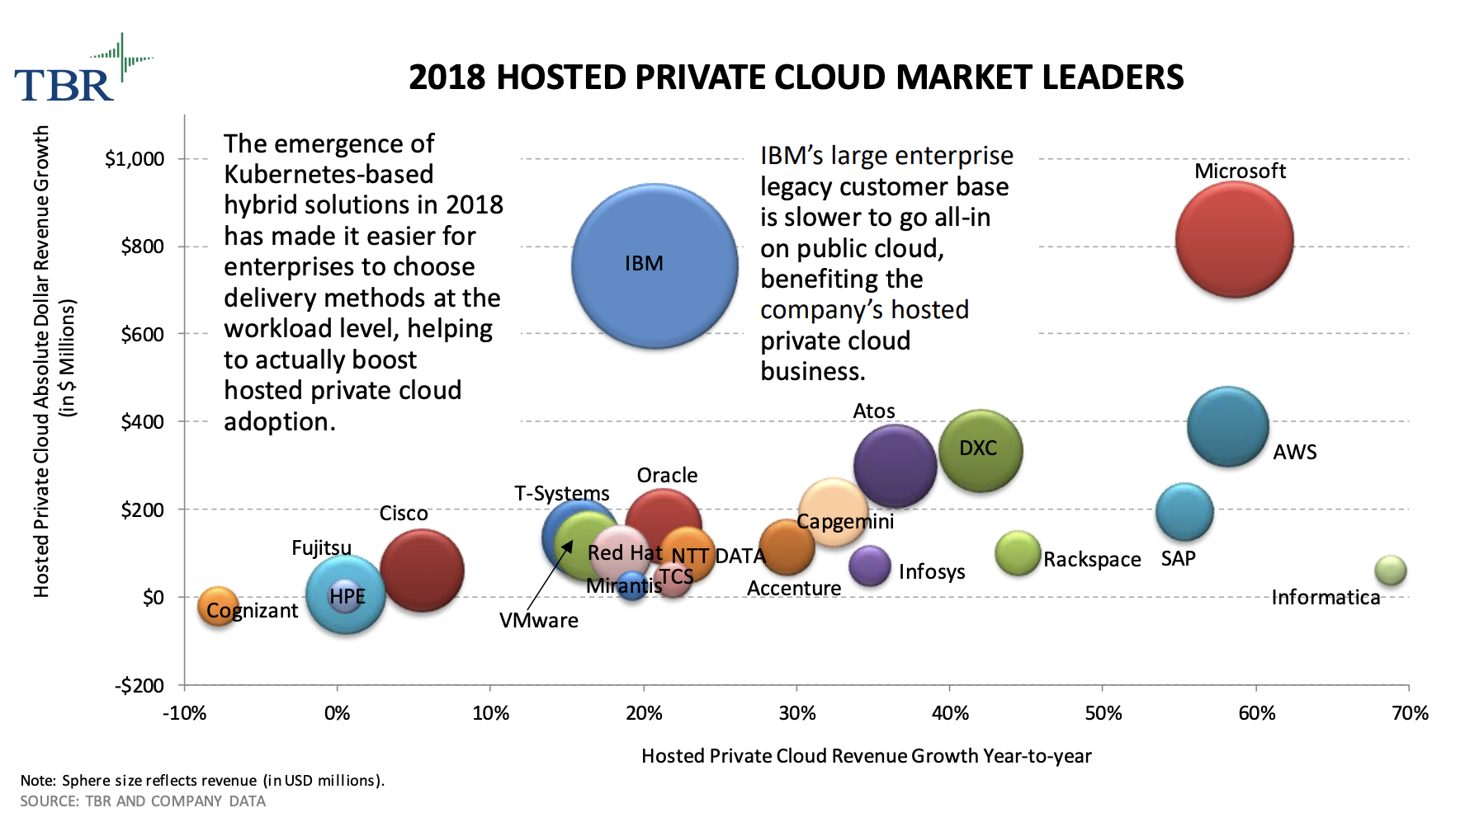
Kubernetes contributes to Private Cloud growth

Slide 35
Customers are operating applications across clouds
Moving to true Hybrid Cloud approaches, increasing Private Cloud adoption means that customers are customizing environments across multiple cloud providers – and need robust tools to help them manage these increasingly complex infrastructures
94%
5
67%
Enterprise customers using multicloud approach
Average number of cloud providers per company
Listed multicloud management as a priority concern
Src: IDC Cloud View, IBM Research

Slide 36
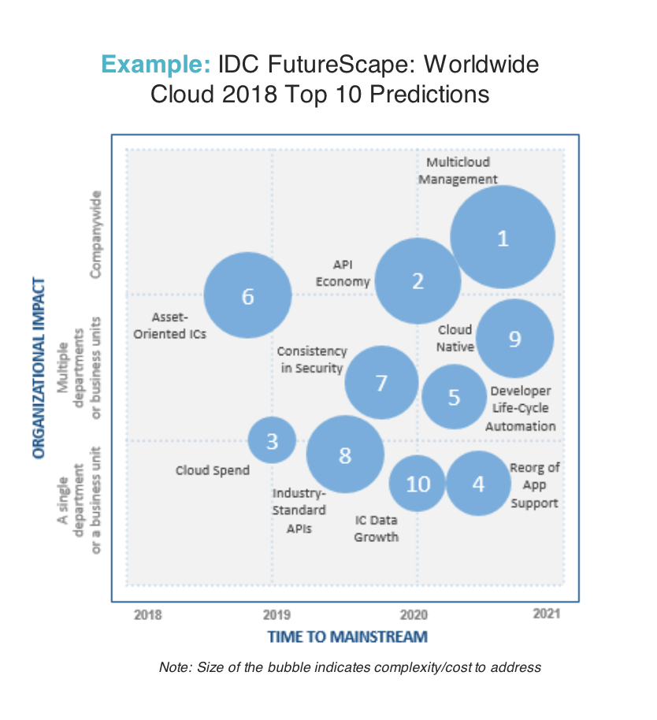
IDC Predicts Multicloud Management to be functionality with largest organizational impact

Slide 37
Visibility across clouds drives tool selection
Fewer than 40 percent of organizations have cloud configuration management tools that provide information about resource configuration and relationships between resources.
What are the most important drivers for your organization's selection of cloud management software and services?
Source: IDC Multicloud Management Survey, March 2019

Slide 38
Kubernetes users are deploying across clusters
More and more customers are using Kubernetes to orchestrate their containerized services. While K8s provides increased scalability and shortens time to deployment, it presents additional management and monitoring challenges – especially across K8 clusters.
200%
9/10
#1
Increase in Kubernetes adoption since 2017
Enterprises adopting Kubernetes have already deployed across multiple clusters
Multi-cluster management is listed as top K8 capability concern for 38% of survey respondents
Src: IBM Research, https://www.nirmata.com/2019/01/24/new-survey-yields-kubernetes-as-mainstream/

Slide 39
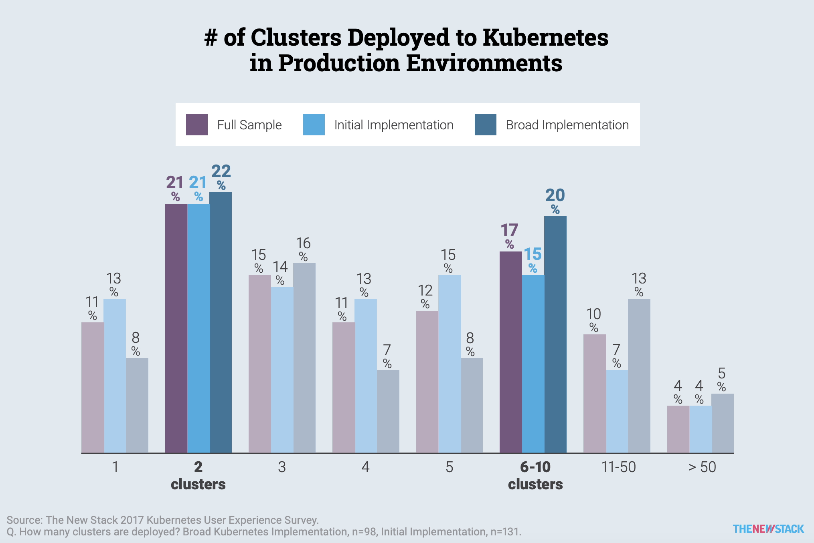
AVERAGE KUBERNETES ENIVRONMENT:
23 CLUSTERS

Slide 40
Total Market:
$10.1B
by 2021
Multicloud Management at a glance
23% CAGR
Multicloud Operations
Management:
$5.1B
by 2021
Management Platforms
& Tool Vendors:
$700M
by 2021
IDC Worldwide Cloud Systems Management Software Forecast Update, 2017-2021 / Worldwide Cloud System and Service Management Software Forecast, 2019–2023, Gartner MQ for Cloud Management Platforms 2019

Slide 41
MCM + Skipper = Full Multicloud/Multicluster Management
IBM Multi-cloud Manager
Skipper
multicloud
full cloud lifecycle management
overview of environment
multicluster
targeted use case optimized for end-user needs & preferences
drill down to specifics
MCM + Skipper
end-to-end solution that covers full DevOps scope from deployment to triage, CIO to SRE

Slide 42
Competitive Landscape

Slide 43
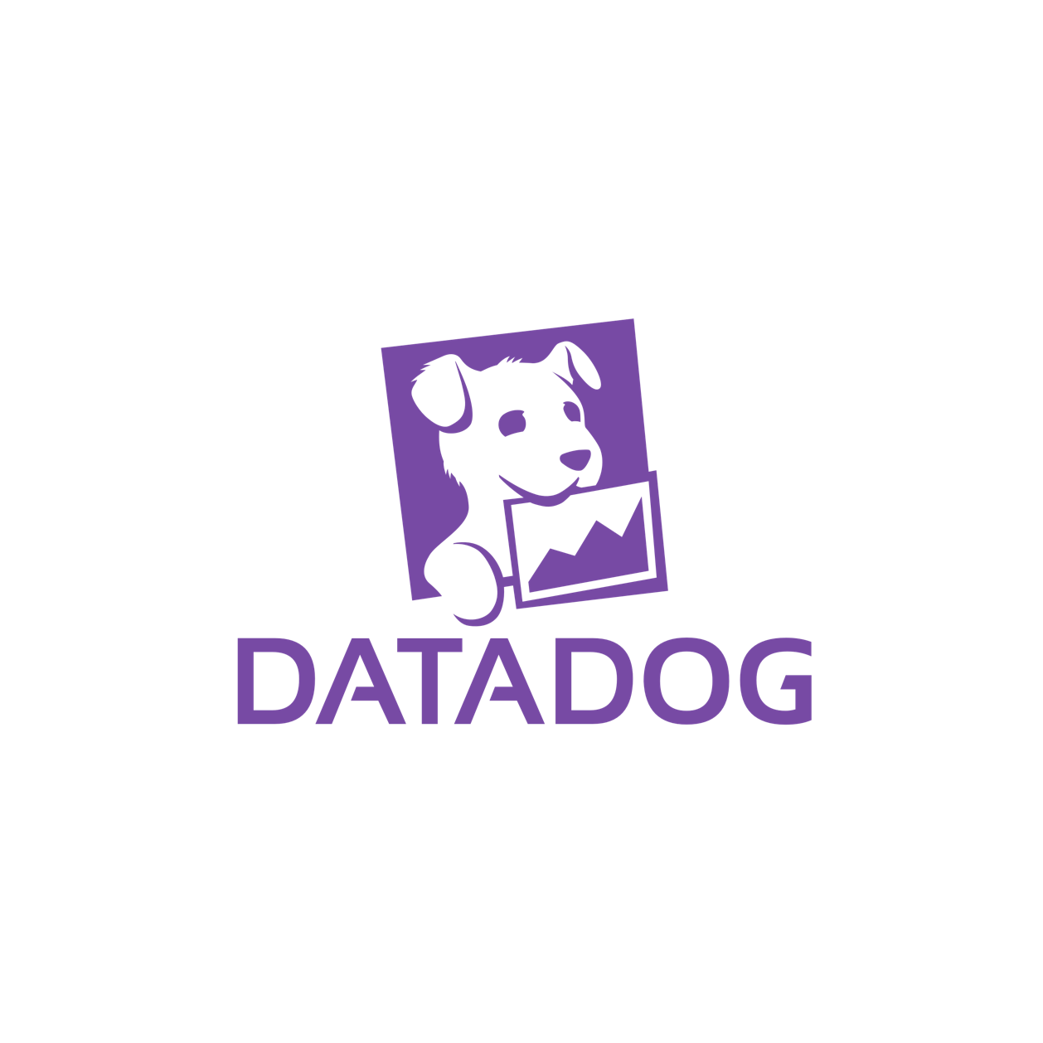
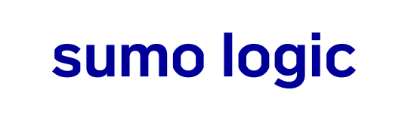
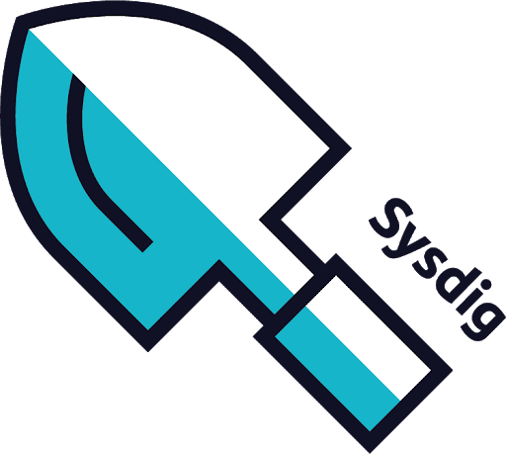

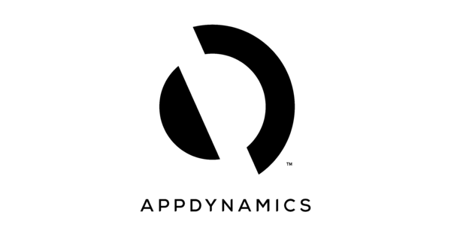
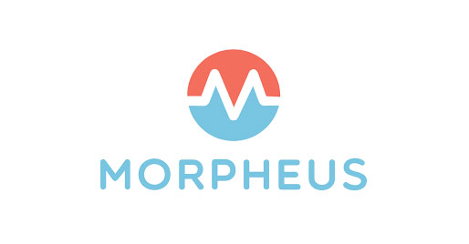
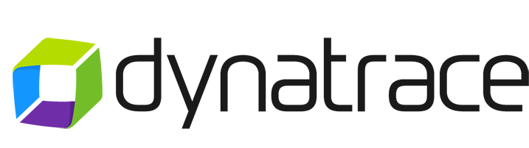

Competitors
Because we will use Skipper to bolster the ecosystem of Multicloud Manager, we concentrate primarily on competitors in that space.
Existing tools are lacking in the following areas:
Few products go beyond application deployment or monitoring to optimize for incident response when an issue occurs
While some claim a “multicloud” approach, none are able to easily switch between K8 contexts to show resources across multiple clusters
None use the application framework to present a full hierarchy of all resources associated with a specific application

Slide 44
Competitor Features
 | Rancher | Datadog | Splunk | Sysdig | AppDynamics | Dynatrace | Sumo Logic | Morpheus
Integrates log data
Native K8 support
Supports public/private/on-prem
Allows users to triage at application level
Management across clusters/clouds
Multi-layered GUI Dashboard
Low
High

Slide 45
RANCHER LABS:
Lightweight container orchestration, deployment and management tool. Rancher gives users robust visibility into multicloud applications, providing both deployment and monitoring capabilities.
Pricing:
Open source to access all features. Enterprise pricing based on vCPU & level of support.
STRENGTHS:
Easy to install across environment. Fast set-up
Commitment to open source
Cross-cloud visibility, compatible with most major providers, as well as on-/off-prem
Focuses on “applications” as well as clusters/pods
Natively optimized for Kubernetes
CLI and GUI
WEAKNESSES:
Only allows for per-cluster management. User has to switch between clusters to manage/triage across clusters and clouds
Has Prometheus integration, but not at application level
No way to access logs
No event monitoring or policy implementation
Cannot triage or manage application across clusters/clouds
HOW SKIPPER DIFFERENTIATES:
Cross-cluster visibility
Integrated log views
CEM capability with policy implementation and event monitoring
Application-wide metrics with Prometheus

Slide 46
DATADOG PLATFORM:
Advanced analytics across infrastructure components to visualize service health and assist in root cause incident analysis.
Pricing:
Prices layered based on desired features/services. Application Performance Management is $31/host/month. Extra for log mgmt, infrastructure, etc
STRENGTHS:
Advanced metrics and analytics capabilities
Surfaces network connections between elements to highlight dependencies
Cross-cloud visibility, compatible with most major providers
Includes log data in output
Interactive infrastructure topology to assist root cause analysis
Anomaly detection capabilities
WEAKNESSES:
Additional integration to optimize for Kubernetes
Doesn’t allow users to manage on-prem installs
Cannot triage or manage application across clusters/clouds
Topology does not include full application K8 hierarchy
Kubernetes view limited to one cluster at a time
HOW SKIPPER DIFFERENTIATES:
Natively optimized for Kubernetes
Cross-cluster visibility
Doesn’t rely on multi-layered GUI to find relevant info
Application-centric view of full K8 hierarchies

Slide 47
SPLUNK ITSI:
Provides a view of the high-level health and performance of applications and services. Uses ML to help predict outages and find the root cause of issues.
Pricing:
Price by index volume/day (with volume discounts). Ops features require Enterprise license or Cloud subscription; additional fee for support
STRENGTHS:
Advanced metrics and analytics capabilities
Surfaces network connections between elements to highlight dependencies
Interactive infrastructure topology to assist root cause analysis
Integrates with VictorOps for comprehensive event monitoring and incident response
WEAKNESSES:
Additional integration to optimize for Kubernetes
Cannot deploy across clouds; only select providers currently available for integration
Topology does not include full application K8 hierarchy
No cross-cluster visibility
Requires multiple dashboards to access all features
HOW SKIPPER DIFFERENTIATES:
Multicloud, cross-cluster visibility
Relevant information in one, centralized location
Natively optimized for Kubernetes
Application-centric view of full K8 hierarchies

Slide 48
SYSDIG MONITOR:
Application monitoring and troubleshooting tool, optimized natively for Kubernetes. Gives advanced data and interactive service topologies to assist in incident diagnosis and triage.
STRENGTHS:
Already integrable with ICP (Marketplace)
Robust interactive chronology to see metrics over time
Interactive application topology to assist root cause analysis
Advanced policy integration and event monitoring capabilities
WEAKNESSES:
Topology does not include full application K8 hierarchy
No cross-cluster visibility
Can be difficult to navigate between dashboard screens/features
HOW SKIPPER DIFFERENTIATES:
Allows visibility into all K8 resources across clusters
No complicated, multi-layered GUI

Slide 49
APPDYNAMICS (CISCO):
Platform that ties application health to a series of user-defined business metrics, allowing users to assess incident impact on real world objectives.
Pricing:
Customized for each client
STRENGTHS:
Supports major public & private clouds, optimized for Kubernetes
Application-centric management ties app health to user- defined business objectives
Can quickly dive into code-level details from UI
Interactive infrastructure topology
WEAKNESSES:
Application view is per-cloud – can’t manage applications that are defined across cloud providers
No cross-cluster visibility
Recently acquired by Cisco, so prioritizes Cisco-centric platforms and integrations
Supports Kubernetes, but not fully-optimized to display down to K8 level hierarchies
HOW SKIPPER DIFFERENTIATES:
Can define applications across cloud providers
Optimized natively for Kubernetes; presents full K8 hierarchy
Terminal-based UI highlights relevant info for targeted use case

Slide 50
DYNATRACE:
Platform that ties application health to a series of user-defined business metrics, allowing users to assess incident impact on real world objectives.
Pricing:
Priced by instance/node, volume discount based on size of environment
STRENGTHS:
Interactive topology of apps, services, hosts, and data centers that maps dependencies and network traffic
“Automated” anomaly detection to assist root cause analysis
Easy set up and continuous discovery of new containers + microservices
Works across public + private clouds, and on-prem
WEAKNESSES:
Doesn’t appear to categorize by application to provide a holistic over view
Can’t track applications across clouds
No logging or event monitoring integrations
HOW SKIPPER DIFFERENTIATES:
Application-centric view that can manage resources across cloud providers
Quickly see logs, source code, etc directly from Skipper
Other MCM integrations (CEM, CAM, etc) broaden product ecosystem

Slide 51
K8 MONITORING APP:
Monitoring platform for Kubernetes deployments that are self-managed by open source tools. Provides visual metrics and logging tools to spot anomalies.
Pricing:
$180/mo for up to 1GB of ingested log data. $15 add’l for metrics capabilities up to 1,000 datapoints/min
STRENGTHS:
Comprehensive metrics dashboard that is optimized for Kubernetes environments
Extensive public cloud support
Easy set up
WEAKNESSES:
No cross-cluster visibility
Not a comprehensive platform; limited features
No high level application-view; displays Kubernetes elements as independent, individual resources
HOW SKIPPER DIFFERENTIATES:
Application-centric view that can manage resources across cloud providers
Cloud agnostic
Quickly see logs, source code, etc directly from Skipper

Slide 52
MORPHEUS PLATFORM:
Platform that is targeted at self—service multicloud provisioning with governance policies and analytics to optimize costs
Pricing:
Customized for each client
STRENGTHS:
Follows ops lifecycle from initial deployment to operations
Robust log aggregation; easily switch from metrics to logs for individual resources
Wide variety of supported public/private/on-prem clouds
One-click restore from backup instances
WEAKNESSES:
Incident response/triage features are accomplished largely through third-party integrations
“100% stack agnostic” = jack of all trades, master of none
Limited application-centric or cross-cloud views or management capabilities
HOW SKIPPER DIFFERENTIATES:
Optimized for triage use-case
Application-centric view that can manage resources across cloud providers
Lightweight, targeted tool that eliminates dashboard sprawl

Slide 53
Open Source Project “Competitors”
KUBE CTX
Similarities: command line client that allows users to switch more easily between K8s clusters and namespaces.
Weaknesses: still involves lots of detailed command entry (time-intensive) and can’t get more info than the list of the resource on each cluster. Users have to enter new commands each time they want to navigate to a new cluster and still have to resort to native kubctl in order to access logs, yamls, etc
K9s
Similarities: curses-based CLI tool that ”visually” displays resources in cluster. Can see all pods & deployments in a cluster, and pull up logs within tool.
Weaknesses: single cluster. Doesn’t allow you to quickly navigate between deployments/pods, or show all resources at a time (i.e. can only see pods, services, etc and can’t combine views)

Slide 54

Cloud provider competitor offerings
Cloud provider competitors have a few offerings that attempt to address the multicloud management need. However, these products are disparate and often do not cover the full MCM lifecycle, focusing more on deployment and monitoring rather than triage.
Similarly, some competitors (AWS, in particular) do not provide offerings that are fully compatible across clouds and platforms, and many don’t define resources by application, preventing users from viewing and managing feature-related resources across clusters.
Several of these tools are also in early release – containing only beta feature sets or shipped with buggy GUI dashboards that require frequent refreshing.

Slide 55

Cloud competitor offerings
WEAKNESSES:
Argues it can be used in hybrid environments, but appears only to work for AWS or on-prem instances
Complicated pricing structure based on use (Metrics or API Calls)
Displays all resources in a list – can’t detect relationships between elements or app hierarchies
Only in limited release
OFFERING:
CloudWatch collects metrics and logs data for historical analysis
Aggregates information across defined application

Slide 56
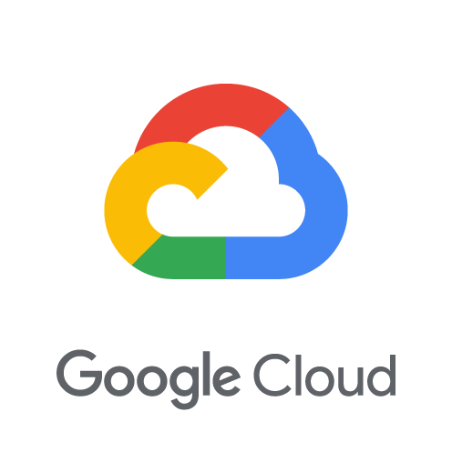
Cloud competitor offerings
WEAKNESSES:
User reviews say it lacks functionality and is much harder to implement for workloads not hosted on GCP, and that the UI is slow to load and throws frequent errors that require restarting
Lists resources across clusters, but does not illustrate hierarchies or dependencies for cross-cluster applications
Complicated pricing structure based on use – each metric (trace, API call, metrics GiB, etc) is priced separately and layered for full price to consumer
Concentrates on listing information in aggregate, rather than drilling down to resource-level data
OFFERING:
Stackdriver Kubernetes Engine Monitoring collects logs, metrics (Prometheus) and events from Kubernetes resources on GKE
Can examine granular details across containers, pods, nodes, workloads, and clusters
Optimized for GKE clusters, works across clouds & on-prem

Slide 57

Cloud competitor offerings
WEAKNESSES:
Can only view resources in categories (Clusters, Nodes, Controllers, Pods), but difficult to see relationships between them
Status information and diagnostics are per-cluster (rather than application)
Optimized for AKS clusters; limited cross-provider functionality
Limited “application” definition – resources are listed independently without defined hierarchy or dependencies
OFFERING:
Azure Monitor for containers that collects metrics and log data
Data is aggregated on container level, then surfaced to pods and nodes

Slide 58
Go To Market

Slide 59
Option 1:
MCM Cloud Pak

Slide 60

Offering Skipper as part of the MCM Cloud Pack
By bundling Skipper into the Multicloud Management Cloud Pak, we will introduce additional features to incentivize customers to choose the premium suite of management tools.
INTEGRATE INCIDENT TRIAGE TO MCM EXPERIENCE
MCM, CEM, and CAM already give operators valuable capabilities to alert them when an issue occurs and begin to point them to possible areas of concern. Skipper can plug into that lifecycle, giving operators a robust tool for in-depth triage and troubleshooting.
DELIVER PREFERRED UX FOR END USERS
More and more, Devs and SREs are driving tool purchase decisions. Providing a component product with UX that is uniquely tailored to the end-user will drive interest for the Pak and position IBM as a provider who listens to & delivers for our target personas
DRIVE MCM CLOUD PAK INTEREST & ADOPTION
By expanding the feature set and accounting for more use cases within the MCM Cloud Pak, we can incentivize more customers to view IBM as the premier destination for end-to-end multicloud management capabilities – one of the fastest growing segments of cloud computing
Img Src: Nikita Golubev via flaticon.com

Slide 61
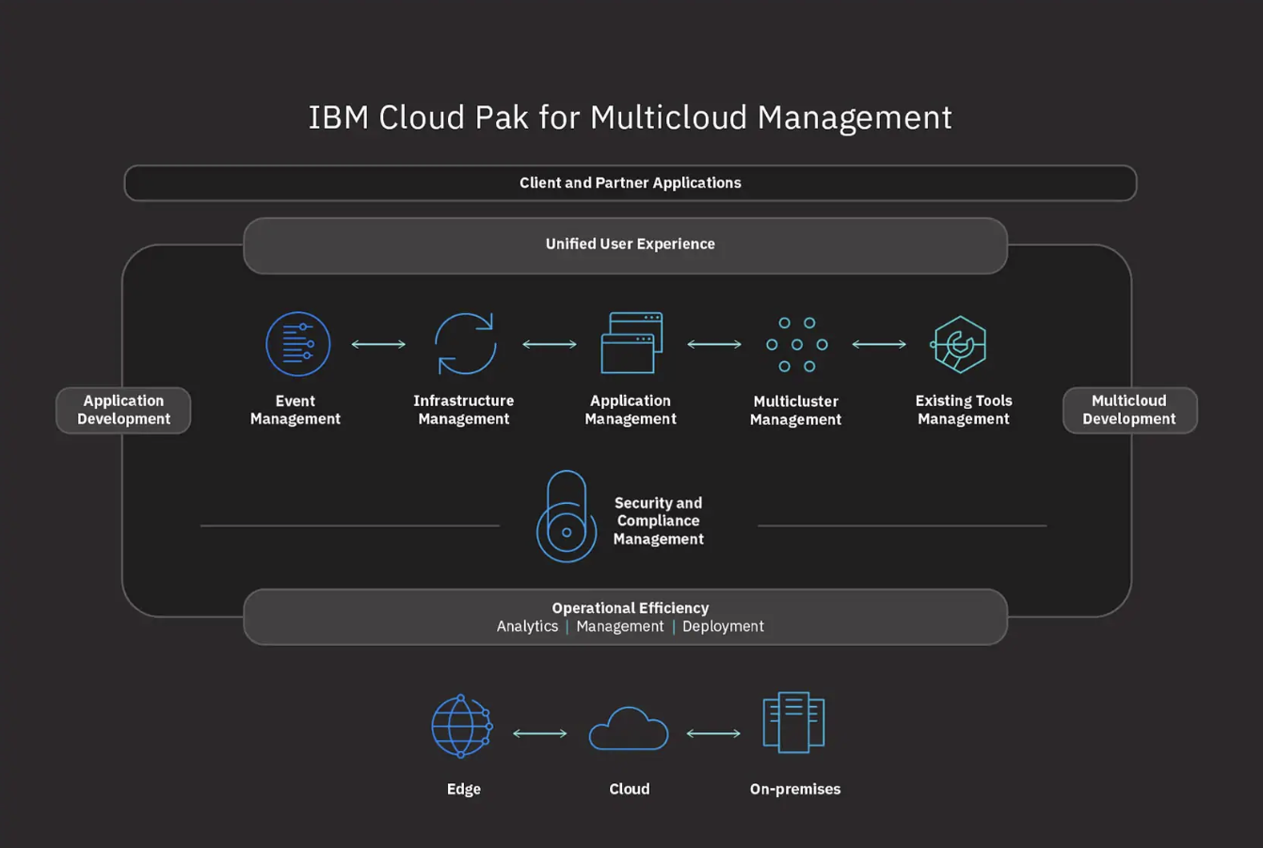
Where Skipper fits into the Cloud Pak

Slide 62
Option 2:
Open Source

Slide 63
Offering Skipper as an Open Source contribution
We’ve built Skipper to be (mostly) cloud & provider agnostic from the ground up – meaning most features will work even if users do not have MCM. However, some powerful components will be “unlocked” after being coupled with the MCM ecosystem.
MCM
MCM
OSS
OSS
APPLICATION MODE
QUERY MODE
CLUSTER MODE
ANOMALY MODE
Only available for resources that are managed by MCM
Basic search included in OSS; some queries (i.e. resources in [application name]) require MCM
Provider agnostic; can use in OSS version
Works across environment; can use in OSS version
Image src: Vectors Market, Freepik, Smashicon via flaticon.com

Slide 64


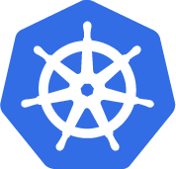
Value of Open-Source Skipper
Releasing Skipper as an OSS tool will help us increase engagement and capture mindshare by increasing trial & awareness of MCM, showcasing the ability to develop against MCM capabilities, and cementing IBM’s position as faithful OSS contributors
INCREASE TRIAL
As a free, open-source product, users can take Skipper for a test drive, experimenting with available modes and increasing awareness of MCM before “levelling up” with advanced features that MCM provides
SHOWCASE MCM TOOLING
By releasing Skipper to the OSS community, we can showcase how developers can build tooling that leverages MCM’s capabilities, allowing us to build the development ecosystem & capture mindshare
LEAD OSS COMMUNITY
IBM has always been committed to the OSS community; releasing pieces of Skipper’s functionality as an OSS product will cement our position as faithful contributors, especially in the containers & Kubernetes community

Slide 65

Current Open Source Modules in Skipper
We’ve leveraged a few open source modules to build Skipper’s core functionality.
Licenses for each are listed below
MODULE | LICENSE
Python Kubernetes Client | Apache 2.0
Requests http Library | Apache 2.0
Multiprocessing | Uncertainty Quantification Foundation
Curses | Python Software Foundation
Flask | BSD
Flask-Migrate | MIT
SQLAlchemy | MIT
PyFiglet | MIT

Slide 66
Risks & Limitations

Slide 67
Risks & Limitations
tktktktktk

Slide 68




Skipper
Notes:
This leaves skipper in an extremely narrow class of robust tools that provide full visibility into an operators application. With Skipper, John can spend less time finding the problem and more time solving it.

Slide 69
Slide Graveyard

Slide 70










As-Is Scenario
John checks the team’s runbooks to see if this kind of error has occurred before and has an established resolution plan. He goes through the runbook steps, but it doesn’t solve the problem
Support creates an incident through John’s alert system. He receives a page that something is wrong with his application.
Customer emails support saying they are having issues with a widget loading on the front-end of the application John manages
John logs in to his incident manager, where he claims the ticket and sees if the incident includes any additional data about what is happening.
Now John needs to come up with his own hypothesis for what is going wrong. First, he checks his metrics dashboard to see if he can spot any spikes in activity or other indications of where the application may be misbehaving
John reaches a dead-end. He needs to go back to the beginning with a new cluster and see what is going on with those pods. He struggles to remember the names of clusters and namespaces that the pods live in. He can’t see his K8 resources across clusters and clouds, so he has to drill down in each area to investigate each piece.
John closes the incident ticket, having successfully fixed the problem and automates for next time
Eventually John finds the resource that he thinks is affected, and has to switch between K8s dashboards and his terminal in order to pull up relevant logs and source code to build the full picture in order to fix the problem.
John has an idea of where the issue might be occurring. He uses his K8 dashboard to navigate to the particular cluster, then investigates individual pods.

Slide 71


To-Be Scenario
John checks the teams runbooks to see if this kind of error has occurred before and has an established resolution plan. He goes through the runbook steps, but it doesn’t solve the problem
Support creates an incident through John’s alert system. He receives a page that something is wrong with his application.
MCM
Customer emails support saying they are having issues with a widget loading on the front-end of the application John manages
John logs in to MCM. Using CEM integrations, he claims the ticket and gets more information about the overall health of his application, and what might be going wrong
John logs in to Skipper. He is able to quickly navigate to just the K8 resources associated with his application. Instead of remembering cluster names and complicated terminal commands, he can quickly navigate to resources across clusters. He dives into a cluster to see pod details, and then jumps to related resources that are also affected, building a clear picture of what’s going on.
John closes the incident ticket, having successfully fixed the problem and automates for next time
Within Skipper, John quickly flips to logs and source code for the element he thinks might be affected. This gives him enough granular detail to develop a full picture for what is going wrong, and being to fix it.
John can also see just a list of what is behaving anomalously in his application. From that list, he can see how these relate and quickly identifies resources that could be the root cause of the issue

Slide 72
Hills / cupcake, birthday cake, wedding cake
+ include feature roadmap (what’s been done / what’s recommended)
TKTKTKTK

